Slide 1
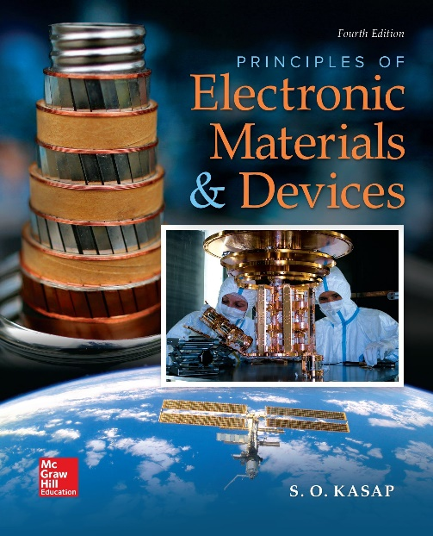
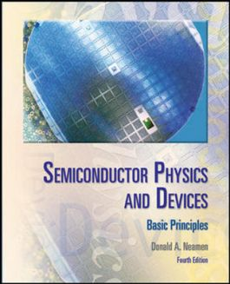

ELECTRONIC MATERIALS AND DEVICES
L | T | P | J | C
3 | 0 | 0 | 0 | 3
Dr. M. Saranya Nair
School of Electronics Engineering
VIT-Chennai Campus
E-mail : saranyanair.m@vit.ac.in
MODULE 5

Slide 2
ELECTRONIC MATERIALS AND DEVICES
MODULE 5
Bipolar Junction Transistor

Slide 3
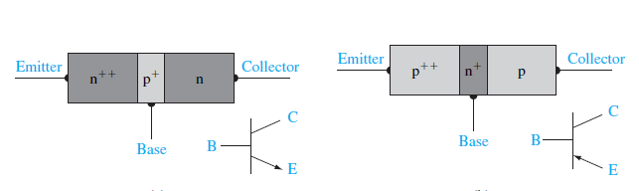
The Bipolar Transistor
The transistor is a multi-junction semiconductor device that, in conjunction with other circuit elements, is capable of current gain, voltage gain, and signal power gain. The transistor is therefore referred to as an active device, whereas the diode is passive.
The basic transistor action is the control of current at one terminal by the voltage applied across the other two terminals of the device.

Slide 4
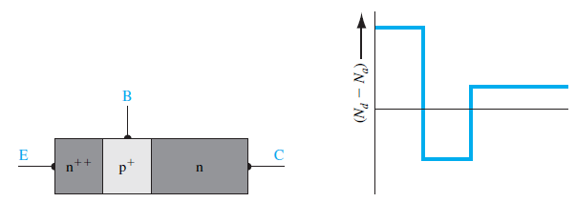
The npn and pnp transistors are complementary devices.
We are going to study the bipolar transistor theory using the npn transistor, but the same basic principles and equations also apply to the pnp device.
Typical impurity doping concentrations in the emitter, base, and collector may be on the order of 10¹⁹, 10¹⁷, and 10¹⁵ /cm³, respectively.

Slide 5
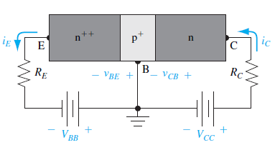
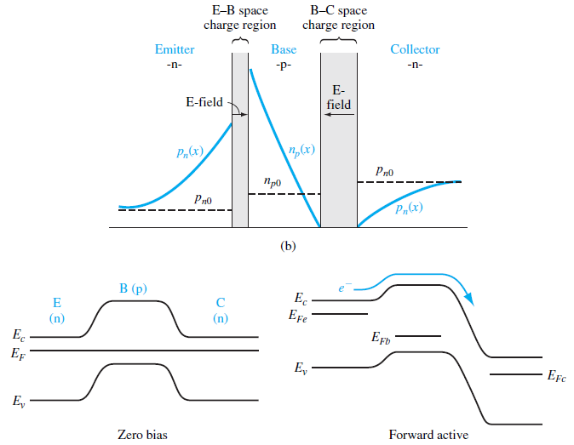

Slide 6
The base–emitter (B–E) pn junction is forward biased and the base–collector (B–C) pn junction is reverse biased in the normal bias configuration.
This configuration is called the forward-active operating mode: The B–E junction is forward biased so electrons from the emitter are injected across the B–E junction into the base. These injected electrons create an excess concentration of minority carriers in the base.
The B–C junction is reverse biased, so the minority carrier electron concentration at the edge of the B–C junction is ideally zero.
The large gradient in the electron concentration means that electrons injected from the emitter will diffuse across the base region into the B–C space charge region, where the electric field will sweep the electrons into the collector.
We want as many electrons as possible to reach the collector without recombining with any majority carrier holes in the base. For this reason, the width of the base
needs to be small.

Slide 7
Ideally, the minority carrier electron concentration in the base is a linear function of distance, which implies no recombination.
The electrons diffuse across the base and are swept into the collector by the electric field in the B–C space charge region.

Slide 8
Transistor Current Relation
Assuming the ideal linear electron distribution in the base, the collector current can be written as a diffusion current.
Collector Current
The diffusion of electrons is in the +x direction so that the conventional current is in the -x direction.
The collector current is controlled by the base–emitter voltage; that is, the current at one terminal of the device is controlled by the voltage applied to the other two terminals of the device.

Slide 9
Emitter Current
One component of emitter current, iE1, is due to the flow of electrons injected from the emitter into the base.
This current, then, is equal to the collector current.
Since the base–emitter junction is forward biased, majority carrier holes in the base are injected across the B–E junction into the emitter. These injected holes produce a pn junction current iE2
This current is only a B–E junction current so this component of emitter current is not part of the collector current. Since iE2 is a forward-biased pn junction current, we can write -------------
The total emitter current is the sum of the two components --------
Since all current components are functions of exp (v_{BE} /V_{t}), the
ratio of collector current to emitter current is a constant ----------
We see that iC < iE or α < 1.
BUT..

Slide 10
Since iE2 is not part of the basic transistor action, we would like this component of current to be as small as possible. We would then like the common-base current gain to be as close to unity as possible.
So,
The collector current is iC = α iE.
To a first approximation, the collector current is independent of the base– collector voltage as long as the B–C junction is reverse biased.

Slide 11
Base Current
The component of emitter current iE2 is a B–E junction current so that this current is also a component of base current shown as iBa. This component of base current is proportional to exp (v_{BE} /V_{t})
There is also a second component of base current. We have considered the ideal case in which there is no recombination of minority carrier electrons with majority carrier holes in the base. However, in reality, there will be some recombination.
Since majority carrier holes in the base are disappearing, they must be resupplied by a flow of positive charge into the base terminal. This flow of charge is indicated as a current iBb.
The number of holes per unit time recombining in the base is directly related to the number of minority carrier electrons in the base. Therefore, the current iBb is also proportional to exp (v_{BE} /V_{t})
The total base current is the sum of iBa and iBb and is proportional to exp (v_{BE} /V_{t})
The ratio of collector current to base current is a constant - called the common-emitter current gain.
Normally, the base current will be relatively small so that, in general, the common-emitter current gain is much larger than unity (on the order of 100 or larger).

Slide 12
Modes of Operation
If the B–E voltage is zero or reverse biased (VBE = 0), then majority carrier electrons from the emitter will not be injected into the base.
The B–C junction is also reverse biased; thus, the emitter and collector currents will be close to zero for this case.
This condition is referred to as cutoff—all currents in the transistor are zero.
When the B–E junction becomes forward biased, an emitter current will be generated, and the injection of electrons into the base results in a collector current. We may write the KVL equations around the collector–emitter loop
This condition is the forward-active region of operation.

Slide 13
As the forward-biased B–E voltage increases, the collector current and hence V_{R} will also increase. The increase in V_{R} means that the reverse-biased C–B voltage decreases, or V_{CB} decreases.
At some point, the collector current may become large enough that the combination of V_{R} and V_{CC} produces 0 V across the B–C junction.
A slight increase in I_{C} beyond this point will cause a slight increase in V_{R} and the B–C junction will become forward biased (V_{CB} < 0). This condition is called saturation.
In the saturation mode of operation, both B–E and B–C junctions are forward biased.

Slide 14
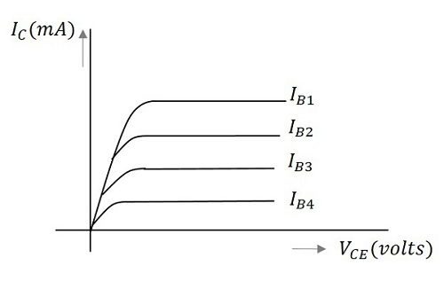
DC Load Line & Q – Point
When the output characteristics of a transistor are considered, the curve looks as below for different input values.

Slide 15
When a value for the maximum possible collector current is considered, that point will be present on the Y-axis, which is nothing but the saturation point.
As well, when a value for the maximum possible collector emitter voltage is considered, that point will be present on the X-axis, which is the cutoff point.
When a line is drawn joining these two points, such a line can be called as Load line.
This line, when drawn over the output characteristic curve, makes contact at a point called as Operating point.
This operating point is also called as quiescent point or simply Q-point. There can be many such intersecting points, but the Q-point is selected in such a way that irrespective of AC signal swing, the transistor remains in active region.

Slide 16
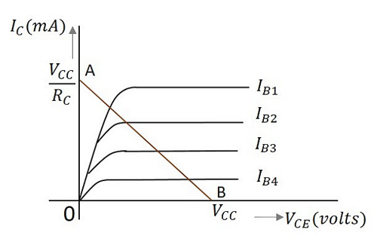
The load line has to be drawn in order to obtain the Q-point. A transistor acts as a good amplifier when it is in active region and when it is made to operate at Q-point, faithful amplification is achieved.
Faithful amplification is the process of obtaining complete portions of input signal by increasing the signal strength. This is done when AC signal is applied at its input.
When the transistor is given the bias and no signal is applied at its input, the load line drawn at such condition, can be understood as DC condition. Here there will be no amplification as the signal is absent.

Slide 17
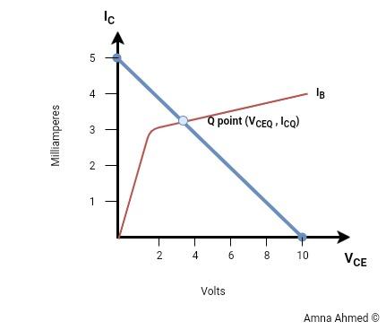
Q - Point
For faithful amplification, V_{CE} should not be less than 1V for silicon transistor.

Slide 18
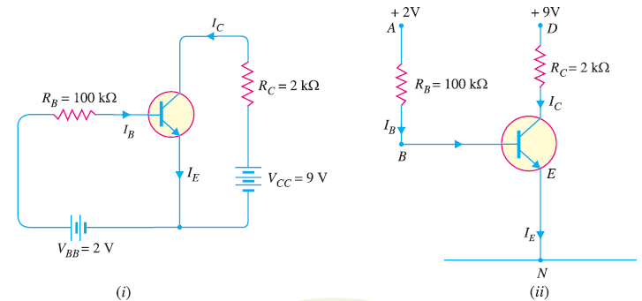
Draw the load line and find the Q- Point

Slide 19
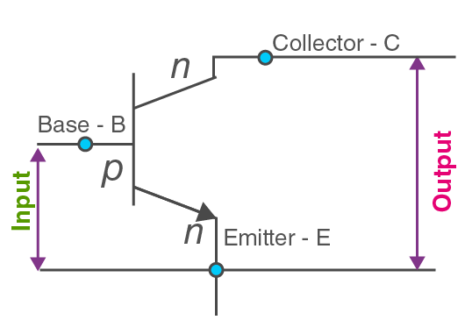
Transistor Characteristics
Input Characteristics: The curve describes the changes in the values of input current with respect to the values of input voltage, keeping the output voltage constant.
Output Characteristics: The curve is obtained by plotting the output current against output voltage, keeping the input current constant.

Slide 20
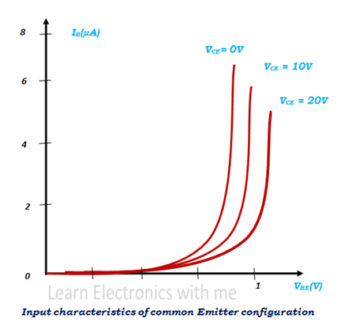
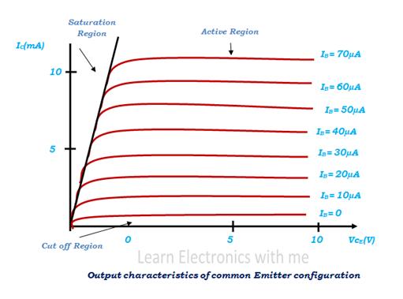

Slide 21
NON-IDEAL EFFECT - BWM
In all previous discussions, a transistor is considered with uniformly doped regions, low injection, constant emitter and base widths, an ideal constant energy bandgap, uniform current densities, and junctions that are not in breakdown. If any of these ideal conditions is not present, then the transistor properties will deviate from the ideal characteristics.
Base Width Modulation
We have implicitly assumed that the neutral base width xB is constant. This base width, however, is a function of the B–C voltage, since the width of the space charge region extending into the base region varies with B–C voltage.
As the B–C reverse-biased voltage increases, the B–C space charge region width increases, which reduces xB.
A change in the neutral base width will change the collector current
A reduction in base width will cause an increase in the diffusion current.
This effect is known as base width modulation; it is also called the Early effect.

Slide 22
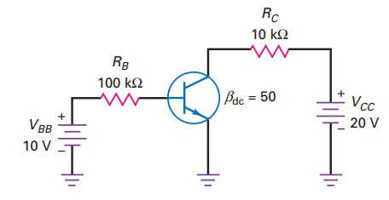
Hard Saturation
For Amplification (in practical cases), V_{CE} should not be less than 1V for silicon transistor.
For Saturation in all conditions, β_{circuit} <<< β_{device}
Based on long experience in circuit design, a circuit will surely operates in hard saturation when the ratio of collector to base current (β) is 10. The smaller the better.
Analyze the above circuit for hard saturation . Find the suitable R_{B} value for hard saturation.

Slide 23
An npn silicon transistor has V_{CC} = 6 V and the collector load R_{C} = 2.5 kΩ. Find the maximum collector current that can be allowed during the application of signal for faithful amplification.
Collector supply voltage, V_{CC} = 6 V Collector load, R_{C} = 2.5 kΩ We know that for faithful amplification, V_{CE} should not be less than 1V for silicon transistor. ∴ Max. voltage allowed across R_{C} = 6 − 1 = 5 V ∴ Max. allowed collector current = 5 V/R_{C} = 5 V/2.5 kΩ = 2 mA

Slide 24
2. A transistor employs a 4 kΩ load and V_{CC} = 13V. What is the maximum input signal if β = 100 ? Given V_{knee} = 1V and a change of 1V in V_{BE} causes a change of 5mA in collector current.
Collector supply voltage, V_{CC} = 13 V Knee voltage, V_{knee} = 1 V Collector load, R_{C} = 4 kΩ ∴ Max. allowed voltage across R_{C} = 13 − 1 = 12 V ∴ Max. allowed collector current, i_{C} =12 V /R_{C} = 12 V/ 4 KΩ = 3 mA
Maximum base current, i_{B} = i_{C} / β = 3 mA / 100 = 30 μA
Now Collector current / Base voltage (signal voltage) = 5 mA/V
∴ Base voltage (signal voltage) = Collector current / (5 mA/V )= 3 mA /( 5 mA/V) = 600 mV

Slide 25
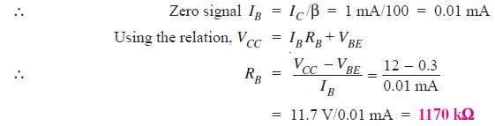
3. A germanium transistor is to be operated at zero signal I_{C} = 1mA. If the supply V_{BB} = 12V, what is the value of R_{B} in the base resistor method ? Take β = 100.
Given, V_{BB} = 12 V, β = 100
As it is a Ge transistor, therefore, V_{BE} = 0.3 V
I_{C} = 1 mA

Slide 26
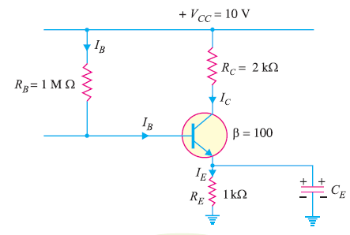
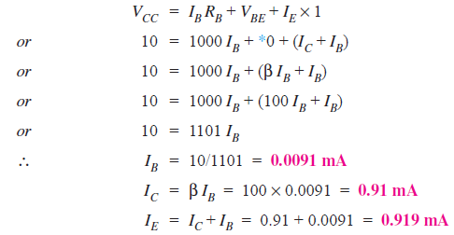
4. Calculate the values of three currents in the circuit

Slide 27
5. Analyze the characteristics and modes of operation. Current Gain of device = 50.
Solution :
1. Draw the characteristics, load line & find Q – Point - Explain
2. Explain the modes with conditions.
3. Explain hard saturation with conditions.

